Slide 1


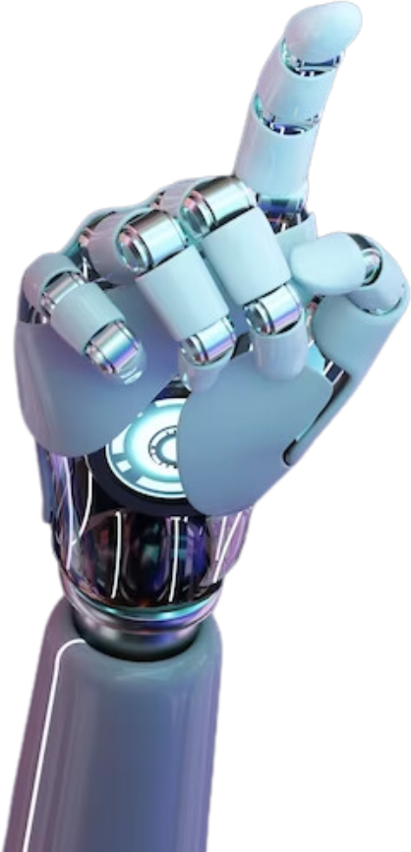
HEALTHCARE FEEDBACK ANALYZER
Name: PALAK, NAVDHA, PRIYANSHI
Course: B.Tech. AI
Subject: Foundations of AI Programming using Python
Submitted to: DR. SHAKSHI SHARMA

Slide 2

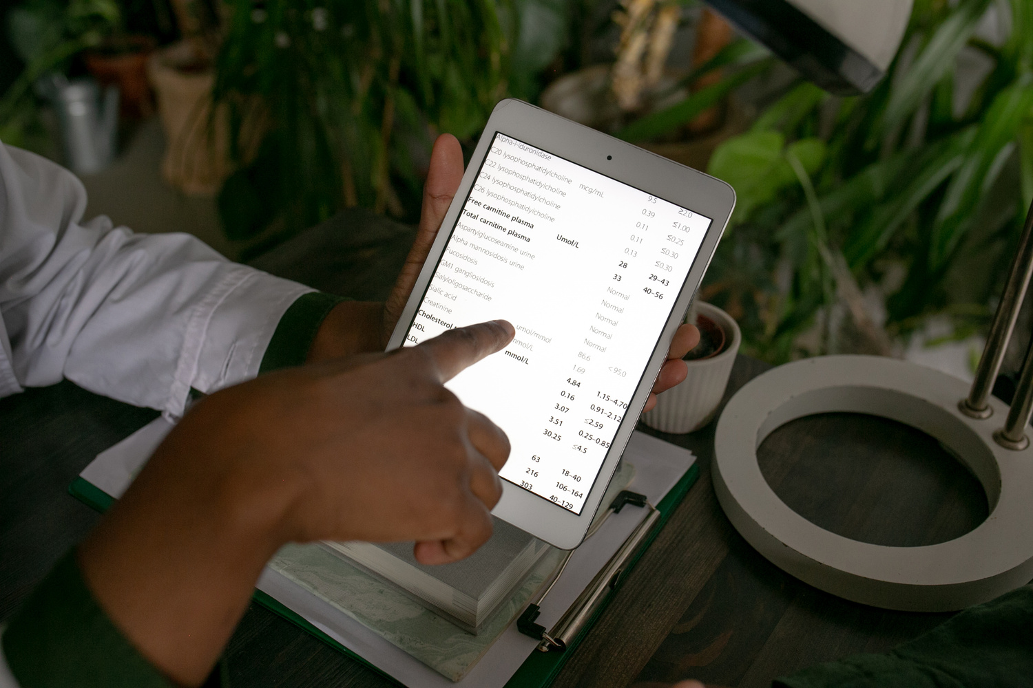
PROBLEM STATEMENT
•Healthcare institutions receive a large amount of feedback from patients regarding services such as staff behavior, waiting time, facilities, billing, and treatment quality.
•Analyzing this feedback manually is time-consuming and inefficient. Important issues may be overlooked, leading to poor service improvement.
•Therefore, there is a need for an automated system that can analyze and categorize feedback efficiently.

Slide 3
OBJECTIVE
The main objectives of this project are:
To automatically classify healthcare feedback into categories
Categories include: staff, delay, facility, billing, and treatment
To reduce manual effort in analyzing feedback
To build a simple and user-friendly web interface

Slide 4
PROPOSED SOLUTION
This project proposes a hybrid system that combines:
•Rule-based keyword matching
•Machine Learning model (Naive Bayes)
•The system analyzes input feedback and categorizes it into relevant classes.
•A web interface is developed using Streamlit to allow users to easily interact with the system.

Slide 5
METHODOLOGY
The system follows these steps:
•Collect feedback data from dataset
•Preprocess text data
•Convert text into numerical form using Count Vectorizer
•Train a Naive Bayes model
•Apply rule-based keyword matching
•Combine both outputs
•Display final categorized result

Slide 6

TECHNOLOGIES USED
The following technologies are used:
•Python
•Pandas (for data handling)
•Scikit-learn (for machine learning)
•Streamlit (for web interface)
•VS Code (development environment)

Slide 7
WORKING OF THE SYSTEM
The working process of the system is:
•User enters feedback in the web app
•Rule-based system checks for keywords
•Machine learning model predicts category
•Both outputs are combined
Final categories are displayed to the user

Slide 8
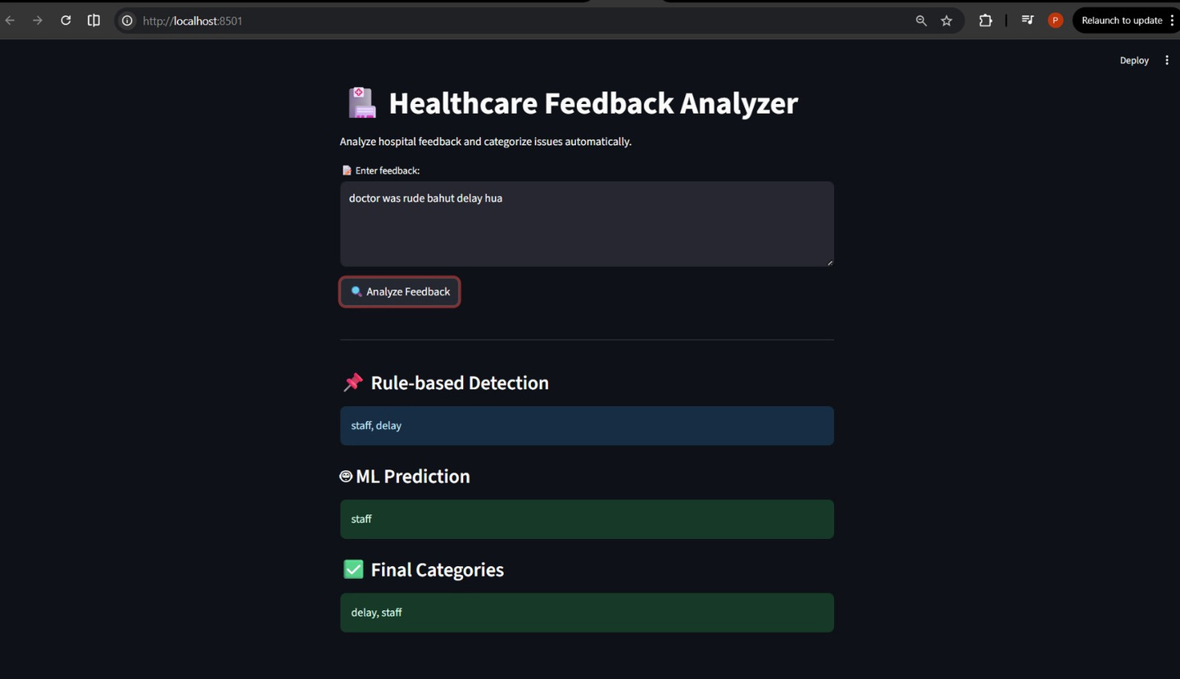
EXAMPLE OUTPUT
Input:
doctor was rude bahut delay hua
Output:
•Rule-based: staff, delay
•ML Prediction: staff
•Final Output: staff, delay
This shows that the system can detect multiple issues from a single feedback.

Slide 9

RESULTS
The system successfully:
•Classifies feedback into multiple categories
•Works with both English and Hindi words
•Provides fast and accurate results
•Improves analysis efficiency

Slide 10
CONCLUSION
•This project demonstrates an efficient system for healthcare feedback classification.
•The hybrid approach of rule-based and machine learning improves accuracy and reliability.
•The system is simple, scalable, and can be used in real-world applications.

Slide 11
FUTURE SCOPE
The project can be further improved by:
•Adding sentiment analysis (positive/negative)
•Using advanced models like deep learning
•Supporting more languages
•Deploying the system online
Expanding the dataset for better accuracy

Slide 12
GITHUB REPOSITORY
The complete project is available on GitHub.
It includes:
•Source code files
•Dataset
•Project report
•PPT
GitHub Link:

Slide 13
THANK YOU!

